Slide 1
Walking Uphill Efficiently With a Load
Tejas Bhagoliwal
Rohit Kharat
Colten Meisner
Thisal Senevirathne

Slide 2
Specific Aims
To study the changes in metabolic cost of walking for different backpack loads and incline angles
To study the effects of varying load placement on metabolic cost
To the study the effects of heel wedges on metabolic cost while walking uphill
Notes:
Thisal

Slide 3
Background
Uphill walking has a greater metabolic cost than walking on level ground^{[1]}
Humans will alter their gait by reducing their walking speed, cadence, and step length to reduce energy expenditure as the incline becomes more strenuous^{[2]}
There is a linear relationship between added load and the increase in metabolic cost^{[3]}
Modifying the center of mass of subjects carrying a load on their back can also affect energy expenditure^{[4]}
In uphill walking, heel wedges which negate the slope of the treadmill have shown to reduce the metabolic cost^{[5]}
Notes:
Tejas

Slide 4
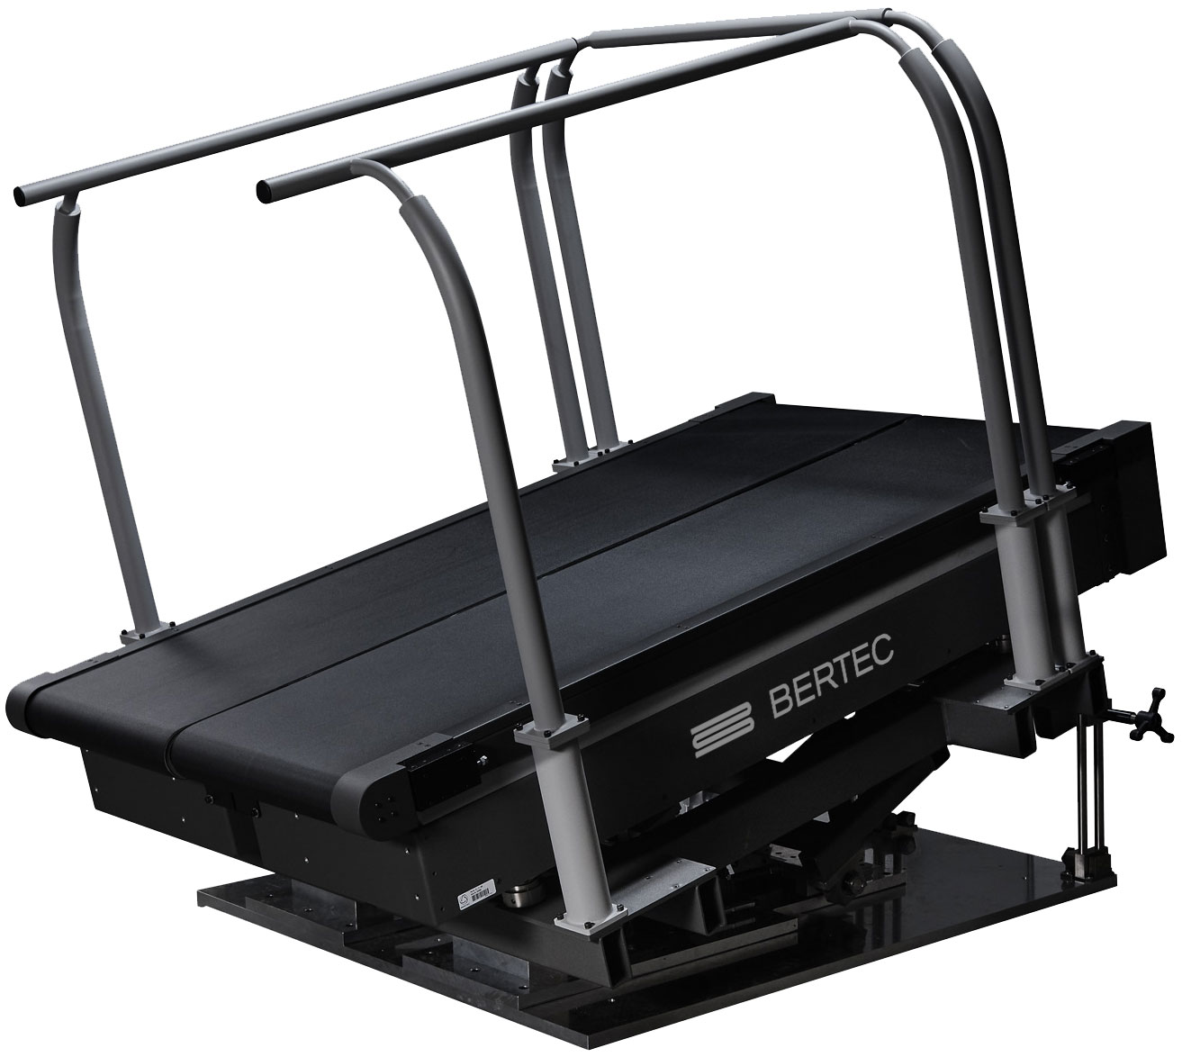
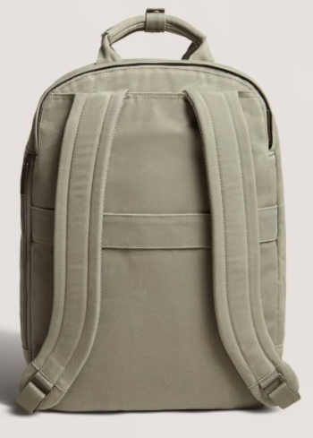
Equipment
Dual-Belt Treadmill w/ force sensors
Measuring Ground Reaction Forces
Indirect calorimetry
Measuring O₂ consumption and CO₂ output
Motion capture system
Joint kinematics data collection
Bilateral backpacks
Custom made shoes

Slide 5
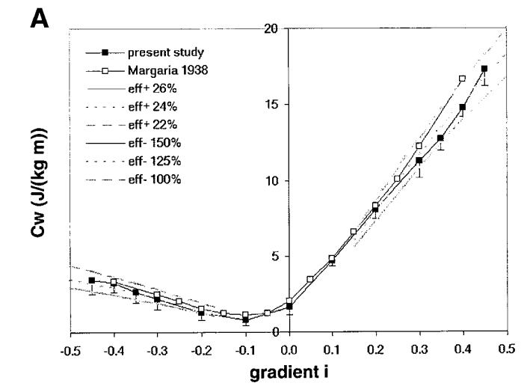
Research Approach
Aim #1: Observing Metabolic Cost At Different Loads And Slope Grades
Understand how metabolic cost for walking changes at different iterations of slope grades and loads
16 different iterations will be tested
Slope Angles: 0°(level), +4°, +8°, and +12°
Loads: 0%, 5%, 10%, 15% of body weight
Costs of walking are claimed to be more sensitive to load
Expect to see higher energy expenditure for trials with loads
Highest EE will be at a +12° slope with a load at 15% of body weight
Source: Cost of walking with respect to hill gradient A. Minetti, et. al; “Energy cost of walking and running at extreme uphill and downhill slopes” pg. 3; 29 Nov. 2002
Notes:
Thisal

Slide 6
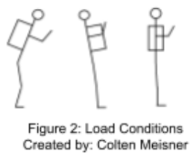
Research Approach
Aim #2: Determining How Load Location Affects Metabolic Cost
12 different iterations per participant
3 load distributions at 4 different inclines
All loads will be 10% of participants weight
Slope Angles: 0°(level), +4°, +8°, and +12°
Load conditions will move along sagittal plane
We expect to see a higher metabolic cost when the load is moved
further from the mid-coronal plane
Must move COM through apex to walk forward
Main musculoskeletal geometry changes expected at pelvis and ankle
Affect forces on muscles
Notes:
Colten

Slide 7
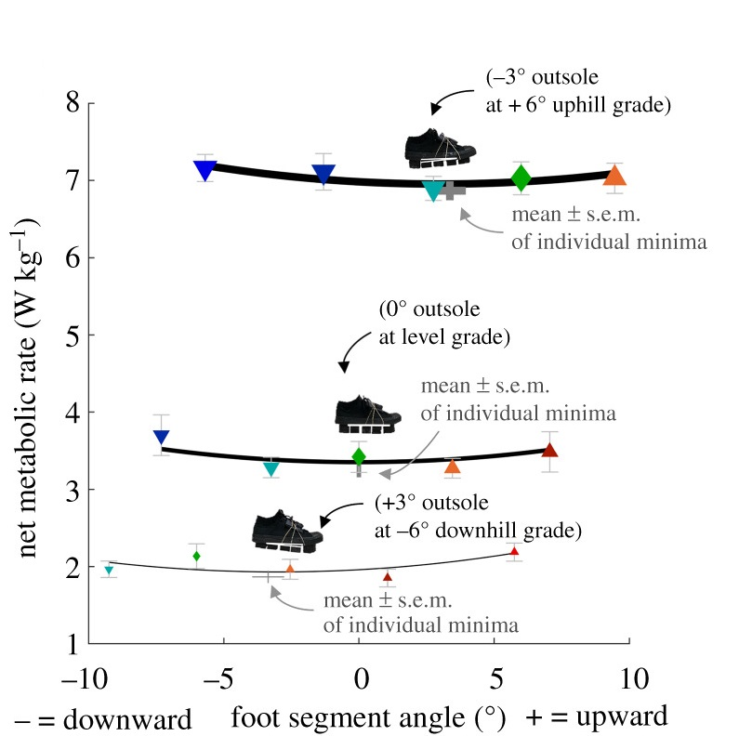
Research Approach
Aim #3: Testing The Effects of Heel Wedges on Metabolic Cost During Uphill Walking
Modular shoe which negate the slope of uphill walking are tested to observe the effect on metabolic cost
8 combinations of treadmill grade and heel wedge angle
Treadmill grade: 0° (level), 4°, 8°, and 12°
Heel wedge angles: 4°, 6°, 8°, 12° (to be designed using blocks of different heights stuck to the outsole)
10% body weight on backpack load
We hypothesise that wedges which negate the slope without significantly restricting plantar- and dorsiflexion will reduce the metabolic cost and joint loads
Source: Antonellis, Prokopios, et al. "Modular footwear that partially offsets downhill or uphill grades minimizes the metabolic cost of human walking."
Notes:
Tejas

Slide 8
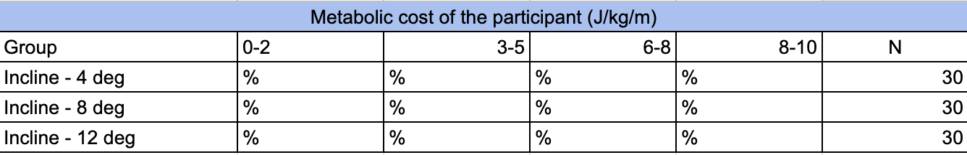
Statistics
Descriptive Statistics:
Measures of central tendency - Mean of the weight of the participants, loads they will carry, and the metabolic cost during the different hypothesis testing will be calculated
Measures of variability - Standard deviation and variance will be calculated for the same variables
Contingency table - To represent interaction between two variables, for e.g., metabolic cost vs. inclination angle
Notes:
Rohit

Slide 9
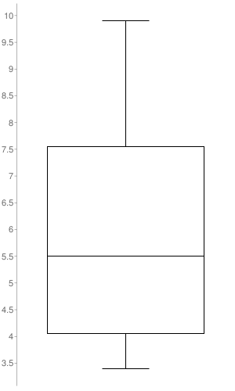
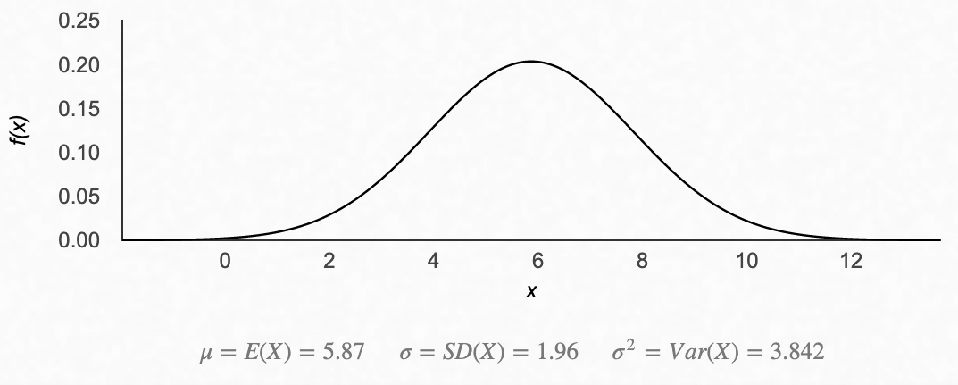
Statistics
Descriptive Statistics:
Box Plots - Visualizing distribution and identifying outliers in measured metabolic cost during different hypothesis testing
Normal distribution curve of metabolic cost can help us to detect and remove outliers
Metabolic cost (J/kg/m)
Metabolic cost for Hypothesis Testing 2
To remove outliers:
Q1 - (1.5*IQR)
Q3 + (1.5*IQR)
Normal Distribution of metabolic cost for Hypothesis Testing 3
Notes:
Rohit

Slide 10
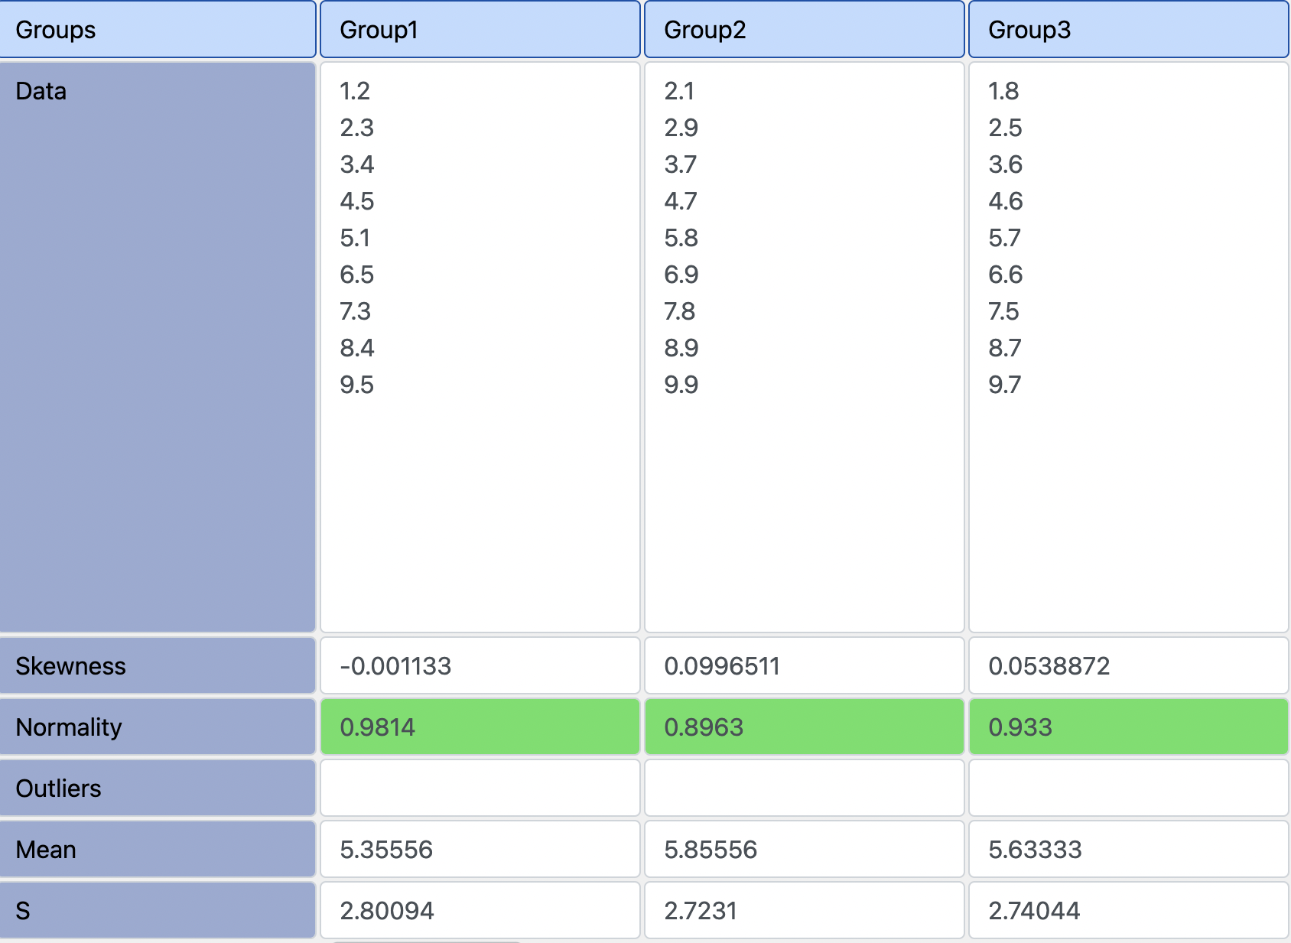
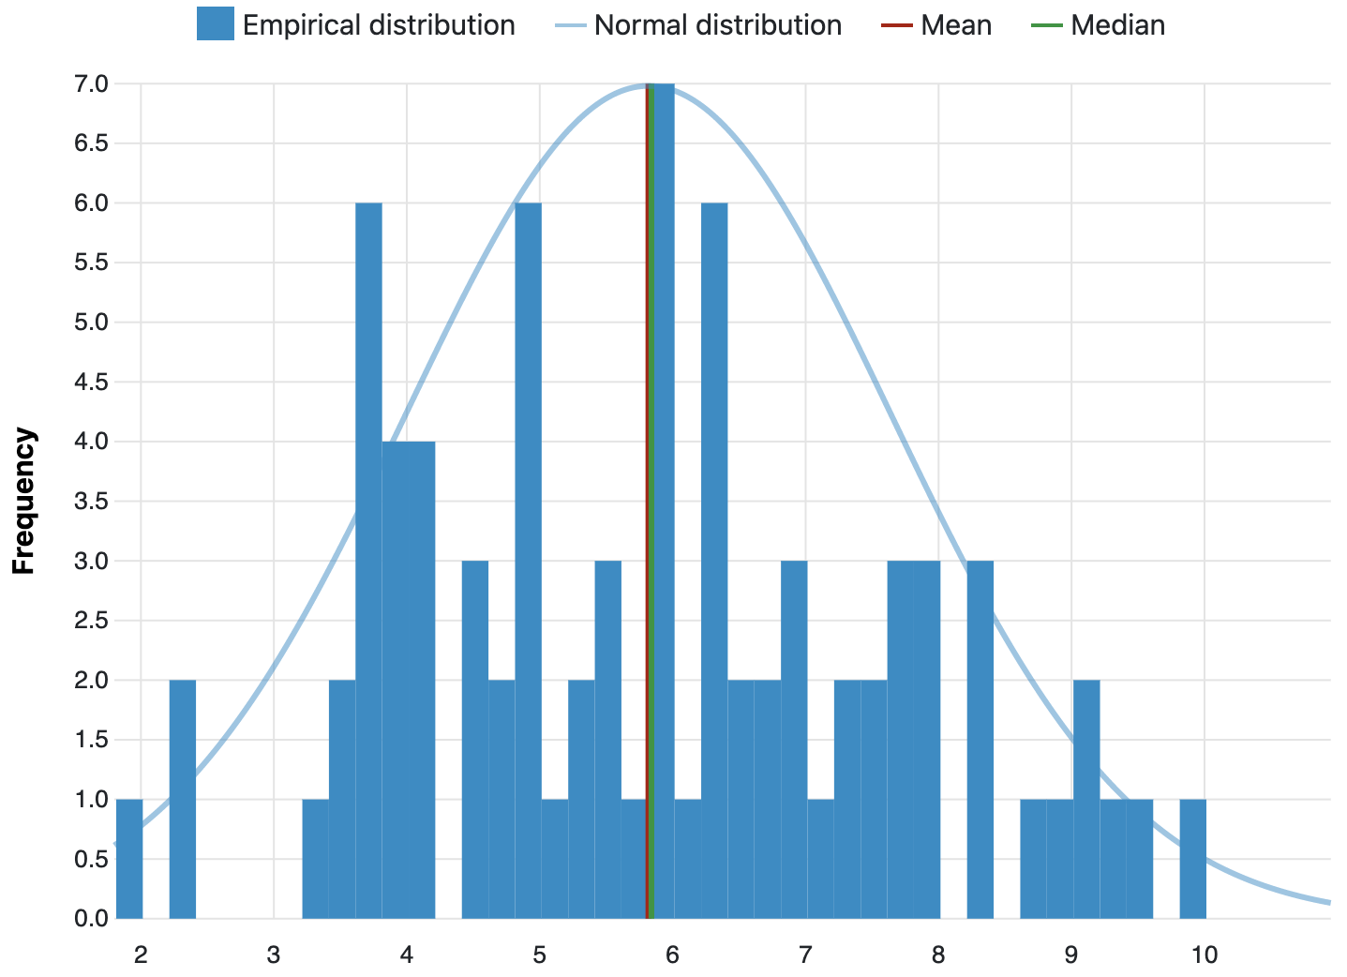
Statistics
Inferential Statistics (α= 0.05):
Anderson-Darling test to determine whether metabolic cost of independent groups are normally distributed
Levene’s test will be used to test whether variance of participant’s metabolic cost for hypothesis testing 2 and 3, are equal over the range of varied load and heel angle
P-value = 0.9986, test statistic = 0.001
Anderson-Darling p-value: 0.3360, with ɑ = 0.05
Notes:
Rohit

Slide 11
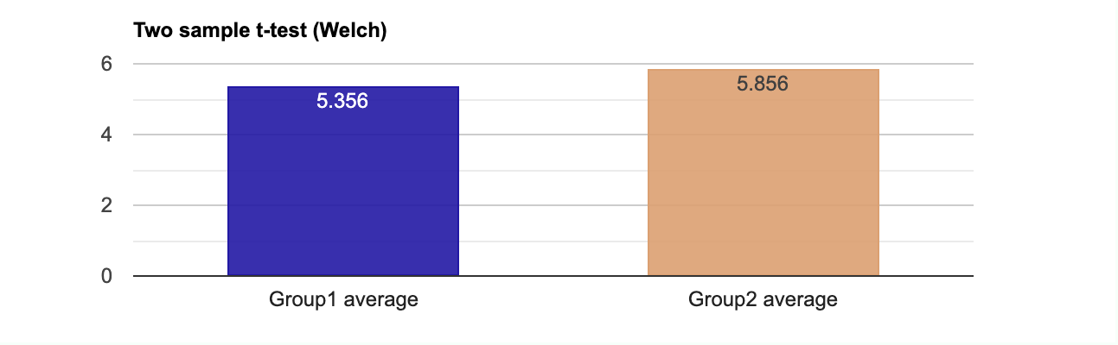
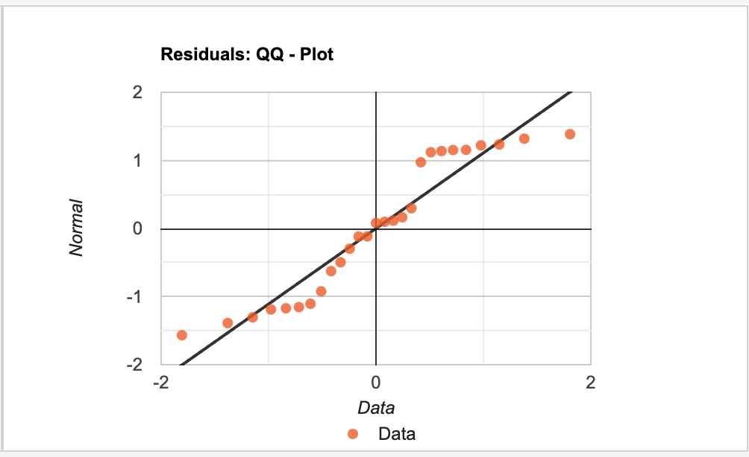

Statistics
Inferential Statistics (α= 0.05):
If data not normally distributed, we will use the Kruskal-Wallis Rank ANOVA test
Otherwise, we will conduct Fisher’s ANOVA test for data groups have equal variance
And, if our data groups have unequal variance, we will use Welch’s ANOVA test
Pearson correlation test between our variables and metabolic cost
Cohen’s effect size criteria will indicate the practical significance of our analysis
P-value = 0.706, test-statistic = -0.3839
r = 0.9453
Notes:
Rohit

Slide 12
Significance
Informative for students that must traverse steep areas on campus and for people hiking uphill with a large backpack
Results can be used to develop more efficient backpack designs and heel wedge development
Research that will primarily look at metabolic cost for loaded uphill walking
Notes:
Colten

Slide 13
Complications
Due to the laboratory setting, and subjects’ inability to alter backpack straps or walking speed, the metabolic cost established during baseline studies cannot be considered identical to a natural outdoor setting
The effect of musculoskeletal geometry and muscle activation resisting the induced torque is complicated to disentangle without EMG data
The effects of the heel wedges and the backpack load on the subjects’ center of mass during inclined walking may interfere
Notes:
Colten

Slide 14
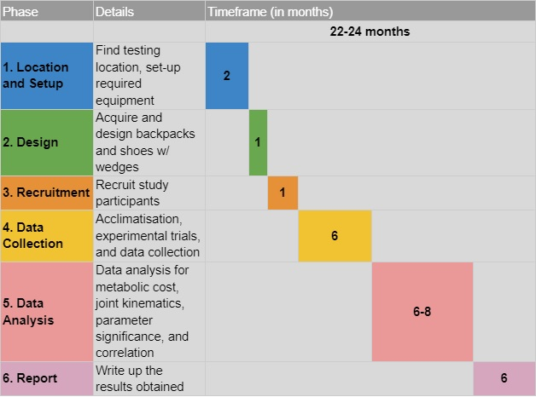
Timeline

Slide 15
References
Pimental, Nancy A., and Kent B. Pandolf. "Energy expenditure while standing or walking slowly uphill or downhill with loads." Ergonomics 22.8 (1979): 963-973.
Sun, Jie, et al. "The influence of surface slope on human gait characteristics: a study of urban pedestrians walking on an inclined surface." Ergonomics 39.4 (1996): 677-692.
Huang, Tzu-wei P., and Arthur D. Kuo. "Mechanics and energetics of load carriage during human walking." Journal of Experimental Biology 217.4 (2014): 605-613.
Smith, Barbara, et al. "Influence of carrying a backpack on pelvic tilt, rotation, and obliquity in female college students." Gait & posture 23.3 (2006): 263-267.
Antonellis, Prokopios, et al. "Modular footwear that partially offsets downhill or uphill grades minimizes the metabolic cost of human walking." Royal Society open science 7.2 (2020): 191527.

Slide 16
Questions?

